Slide 1
Digital Dictionary of
Classic Mayan
a corpus-based dictionary for a not yet fully deciphered language

Slide 2
Project: Text Database and Dictionary of Classic Mayan
AIM
create a digital corpus of inscriptions and their carriers
based on this a dictionary showing the vocabulary and its usage in the script is to be developed

Slide 3
Classic Mayan Script and Language
hieroglyphs with iconic character
logo-syllabic script
ergative language
Notes:
complex graphemes / graph variants
polyvalent signs
not yet fully deciphered
→ multiple reading hypotheses
hieroglyphs with iconic character
logo-syllabic script
ergative language

Slide 4
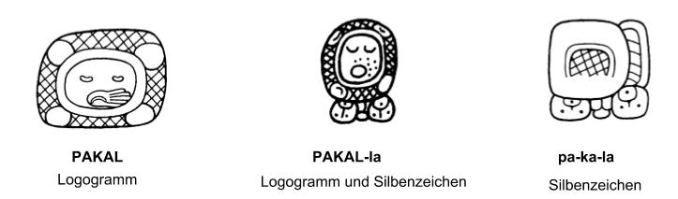
Classic Mayan Script and Language
Logograms and Syllabograms
Drawings: © Montgomery, John: How to Read Maya Hieroglyphs. Hippocrene, New York, NY. 2002, p. 128

Slide 5

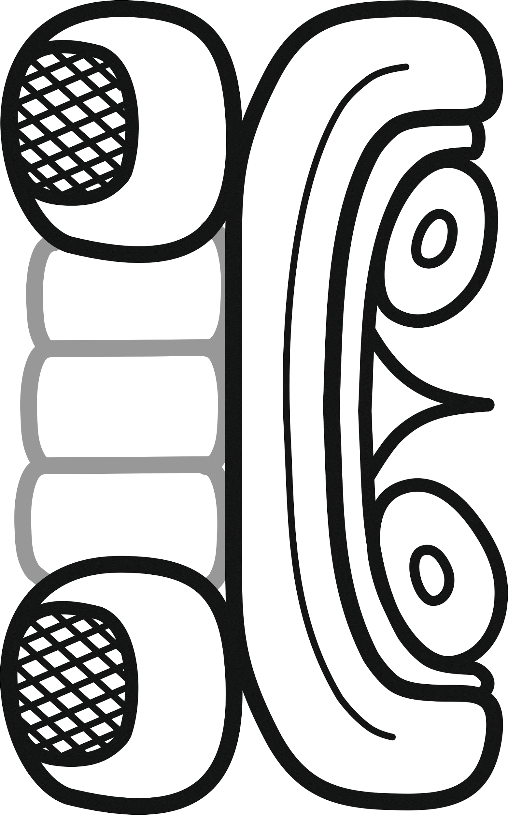



Graphvariants
Syllable /u/
Segmentation I
full variant
Segmentation II
Part Multiplication
Reduction

Slide 6
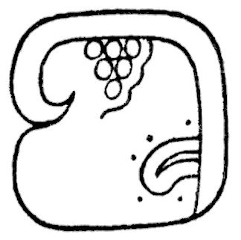
Polyvalence
Sign
528
Reading:
TUN
CHAHUK
ku
Meaning:
Stone
19th Day Name
ku
Function:
Logogram
Logogram
Syllable

Slide 7
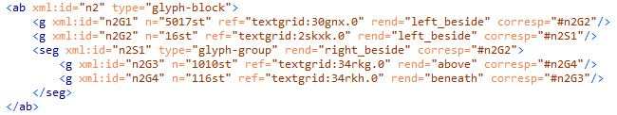
Corpus and Sign Catalogue
Text ≠ transliterated phonemic values
no Unicode
TEI-Coding:
<g ref=”URI-SignCat”/>
Notes:
long-term project 2014 - 2028 (prospectively)
cooperation between Department for Anthropology of the Americas of Uni Bonn (4) and SUB Göttingen (2)

Slide 8
Corpus and Sign Catalogue
Text ≠ transliterated phonemic values
no Unicode
TEI-Coding:
<g ref=”URI-SignCat”/>

Slide 9
Corpus and Sign Catalogue
Text ≠ transliterated phonemic values
no Unicode
TEI-Coding:
<g ref=”URI-SignCat”/>

Slide 10
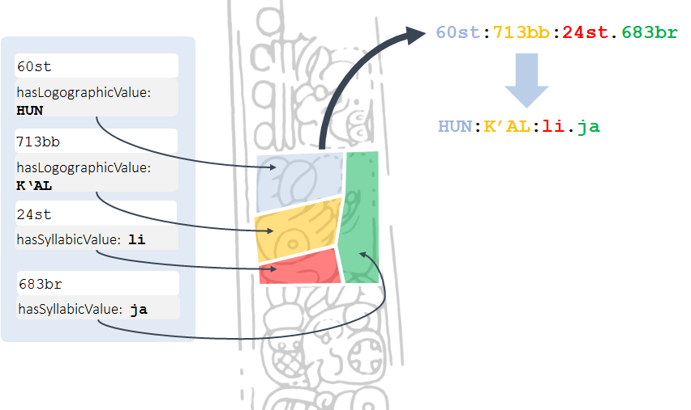
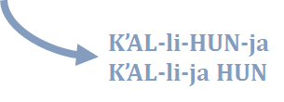
How to get a Readable Text?
linguistic analysis

Slide 11
How to get a Readable Text?
linguistic analysis

Slide 12
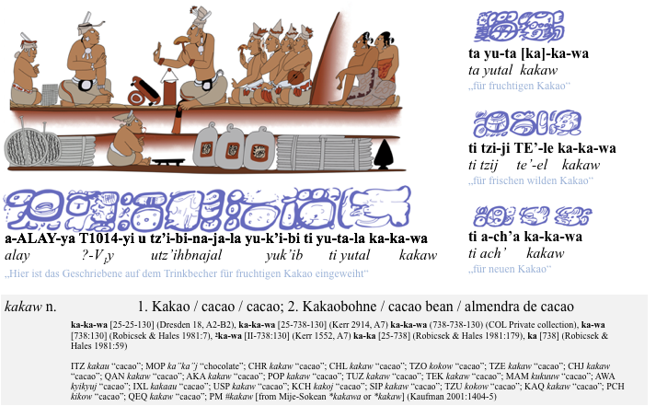
Example Entry

Slide 13
Example Entry

Slide 14
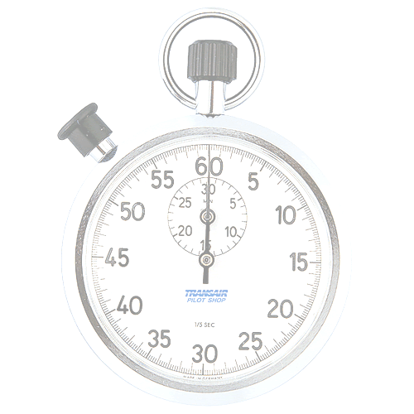
Time’s Up!
About your speaker:
Name: Franziska Diehr
Institution: SUB Göttingen
Twitter: @FranziDiehr
Quick bio: 2014 - now: Text Database and Dictionary of Classic Mayan 2013-2014: Fellow at Association of German Foundations 2010 - 2013: MA Information Science (HU Berlin)
2007-2013: BA Museology (HTW Berlin)

